Slide 1
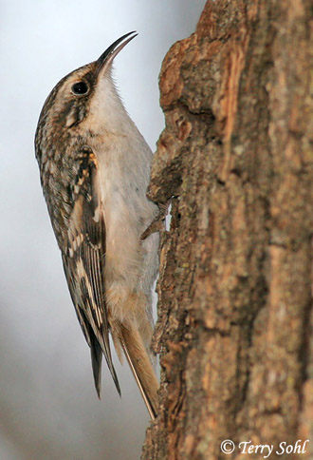
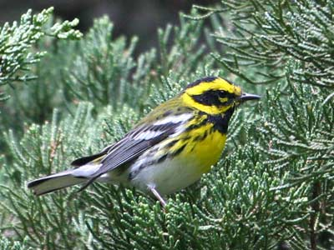
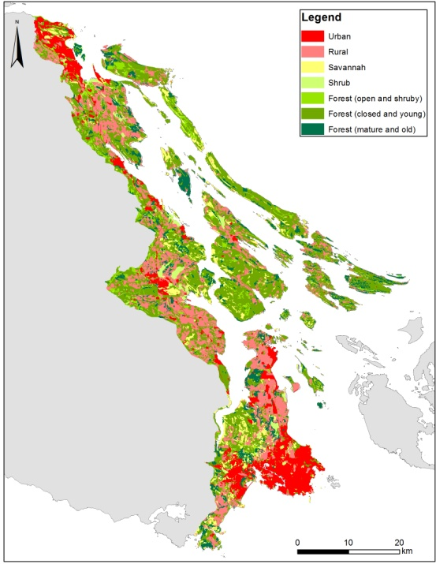
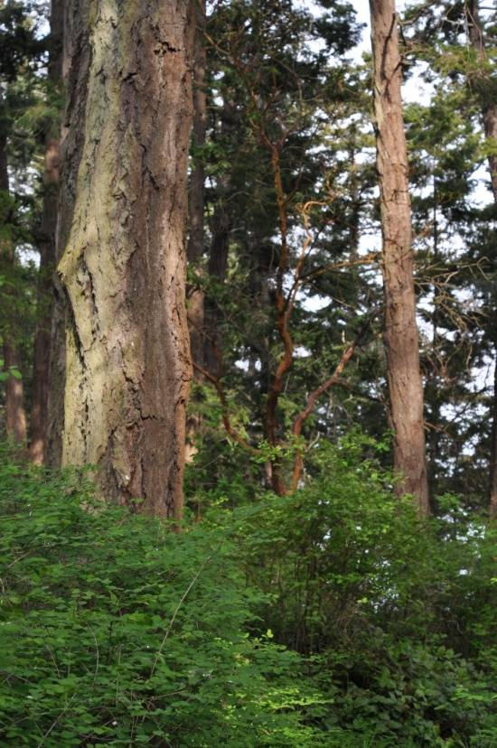
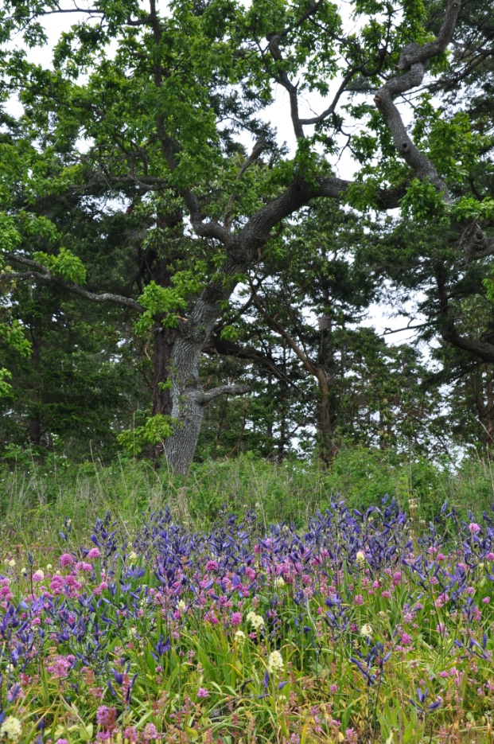
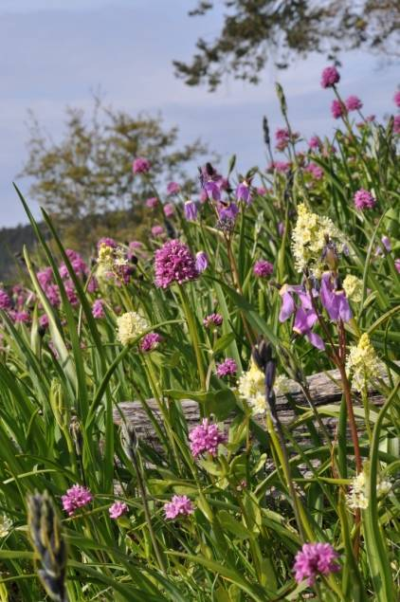
Economic Incentives for Conservation: Offsets, Management Costs and Landscape Context
Notes:
In the Douglas Fir/Garry Oak Woodlands of coastal BC, we are using SCAD to prioritize investments in land conservation, but doing so in a landscape were no ‘intact’ old-growth habitat remains. This raises the interesting question of where to start. In this talk, we’d like to attract your feedback on an evolving approach we are using to prioritize areas for the restoration of ‘old growth’ ecosystems, under the assumption that the best restoration candidates are those areas that currently support the richest communities of species thought to rely on historic habitat attributes.

Slide 2
Existing Incentives
Emerging Incentives
Prioritizing Threats and Actions to Minimize Long-term Management Cost

Slide 3
Conservation Covenants
A Conservation Covenant is a legal commitment by a land owner to protect natural features on their property
Survey land to identify part to be protected
Identify ongoing management activities allowed or required
Estimate value of forgoing development to create a tax advantage

Slide 4
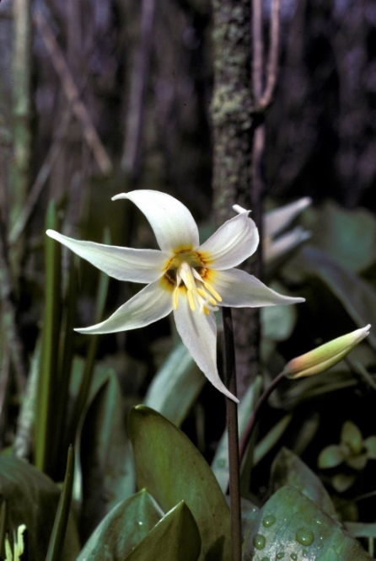
Incentives to Donors
Federal Ecological Gifts Program
Value of encumbering future development results in a tax deduction equal to the decline in land value
1110 ecological gifts valued over $716 million have been donated across Canada to protect 166,000 hectares of wildlife habitat

Slide 5
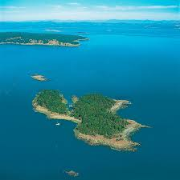
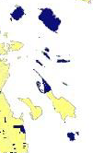
Little D`Arcy
One owner, purchased for $250K
c. 5ha, sub-dividable
Assessed $1,500K
Gifted 90% of Island to Canada
Value of gift reduced taxes to $0 for life

Slide 6

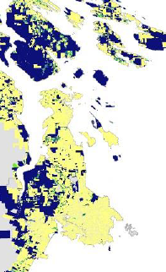
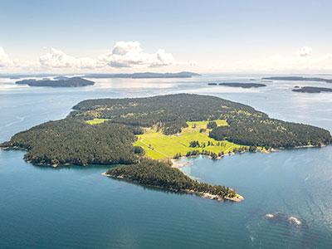
Incentives to Donors
Natural Area Protection Tax Exemption
Owners receive a 65% annual reduction on property taxes for portion of property protected with a NAPTEP covenant
One owner, 19 Parcels
Value ≈ $30 mil
Taxes ≈ $1,000,000
NAPTEP ≈ $650,000
ARL ≈ $850,000

Slide 7
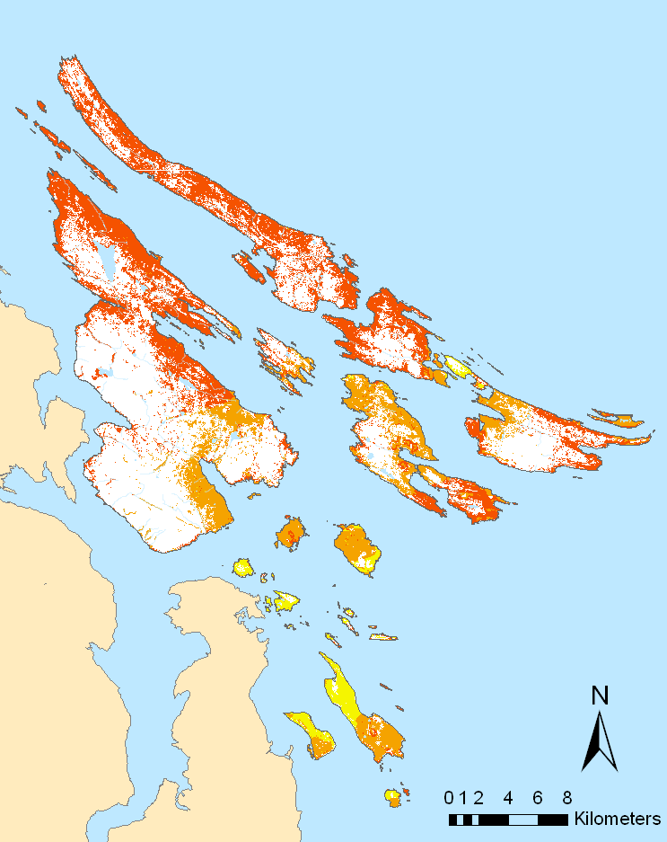
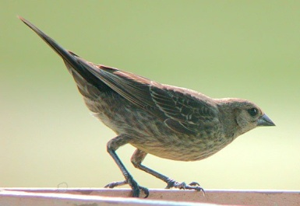
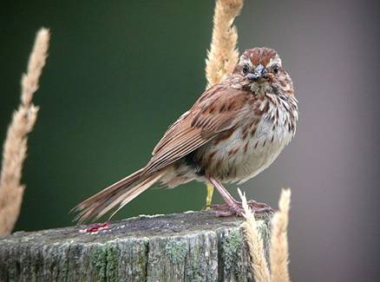
Expected Growth of Song Sparrow Populations Given Cowbird Distribution

Slide 8
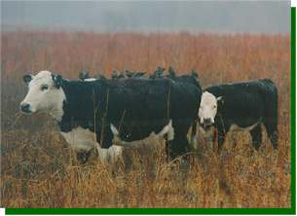
ALR Tax Incentive can be a Perverse Incentive
ALR Credit:
Pays Landowners to Degrade Habitat
Why Not ‘Pay’ to Promote Historic Habitat Conditions?

Slide 9
Examples of Services Rendered
Suggestions?
Passerines Birds (12,000 – 30,000 annually)
Carbon Sequestration
Visual Quality (Boaters, BC Ferries, Land Owners)
Protected Habitat for Rare and Endangered Species
Clams, oysters recreation below tide-line

Slide 10
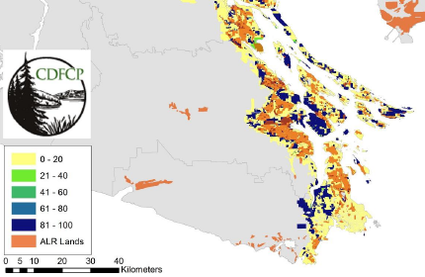
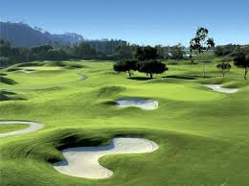
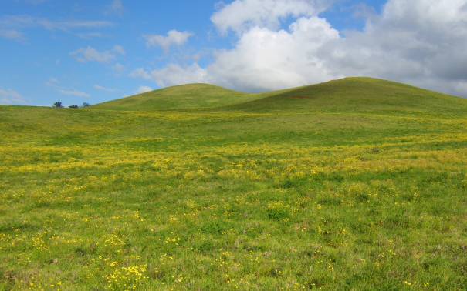
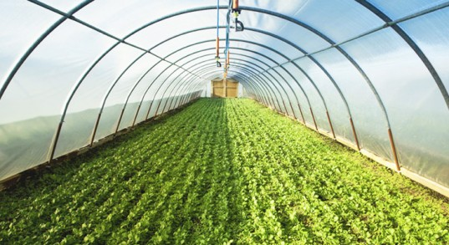
The Agricultural Land Reserve as Corridor and Buffer Habitat
To the Degree that ALR Enhances Conservation Outcomes, Planners Could Enhance Incentives to Maintain It

Slide 11
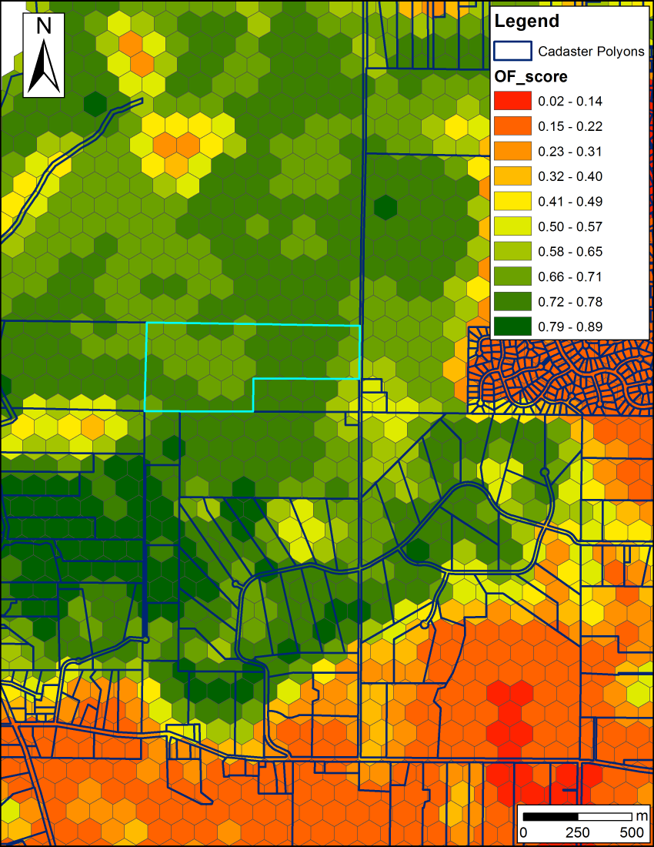
Biodiversity – Carbon Synergy in the Conservation of Forested Land
Biodiversity features
β-diversity of Old Forest and Savanna Bird Communities
Carbon budget model
Standing Carbon
Sequestration potential
Cost metrics used:
Total Land Value (TLV)
TLV – Standing Carbon * $/t
TLV – Sequestration Potential (20a) * $/t
TVL – Stand. Carb *$/t – Sequ. Pot. * $/t
$/t presented: 12.5 (average cost payed by Pacific Carbon Trust)

Slide 12
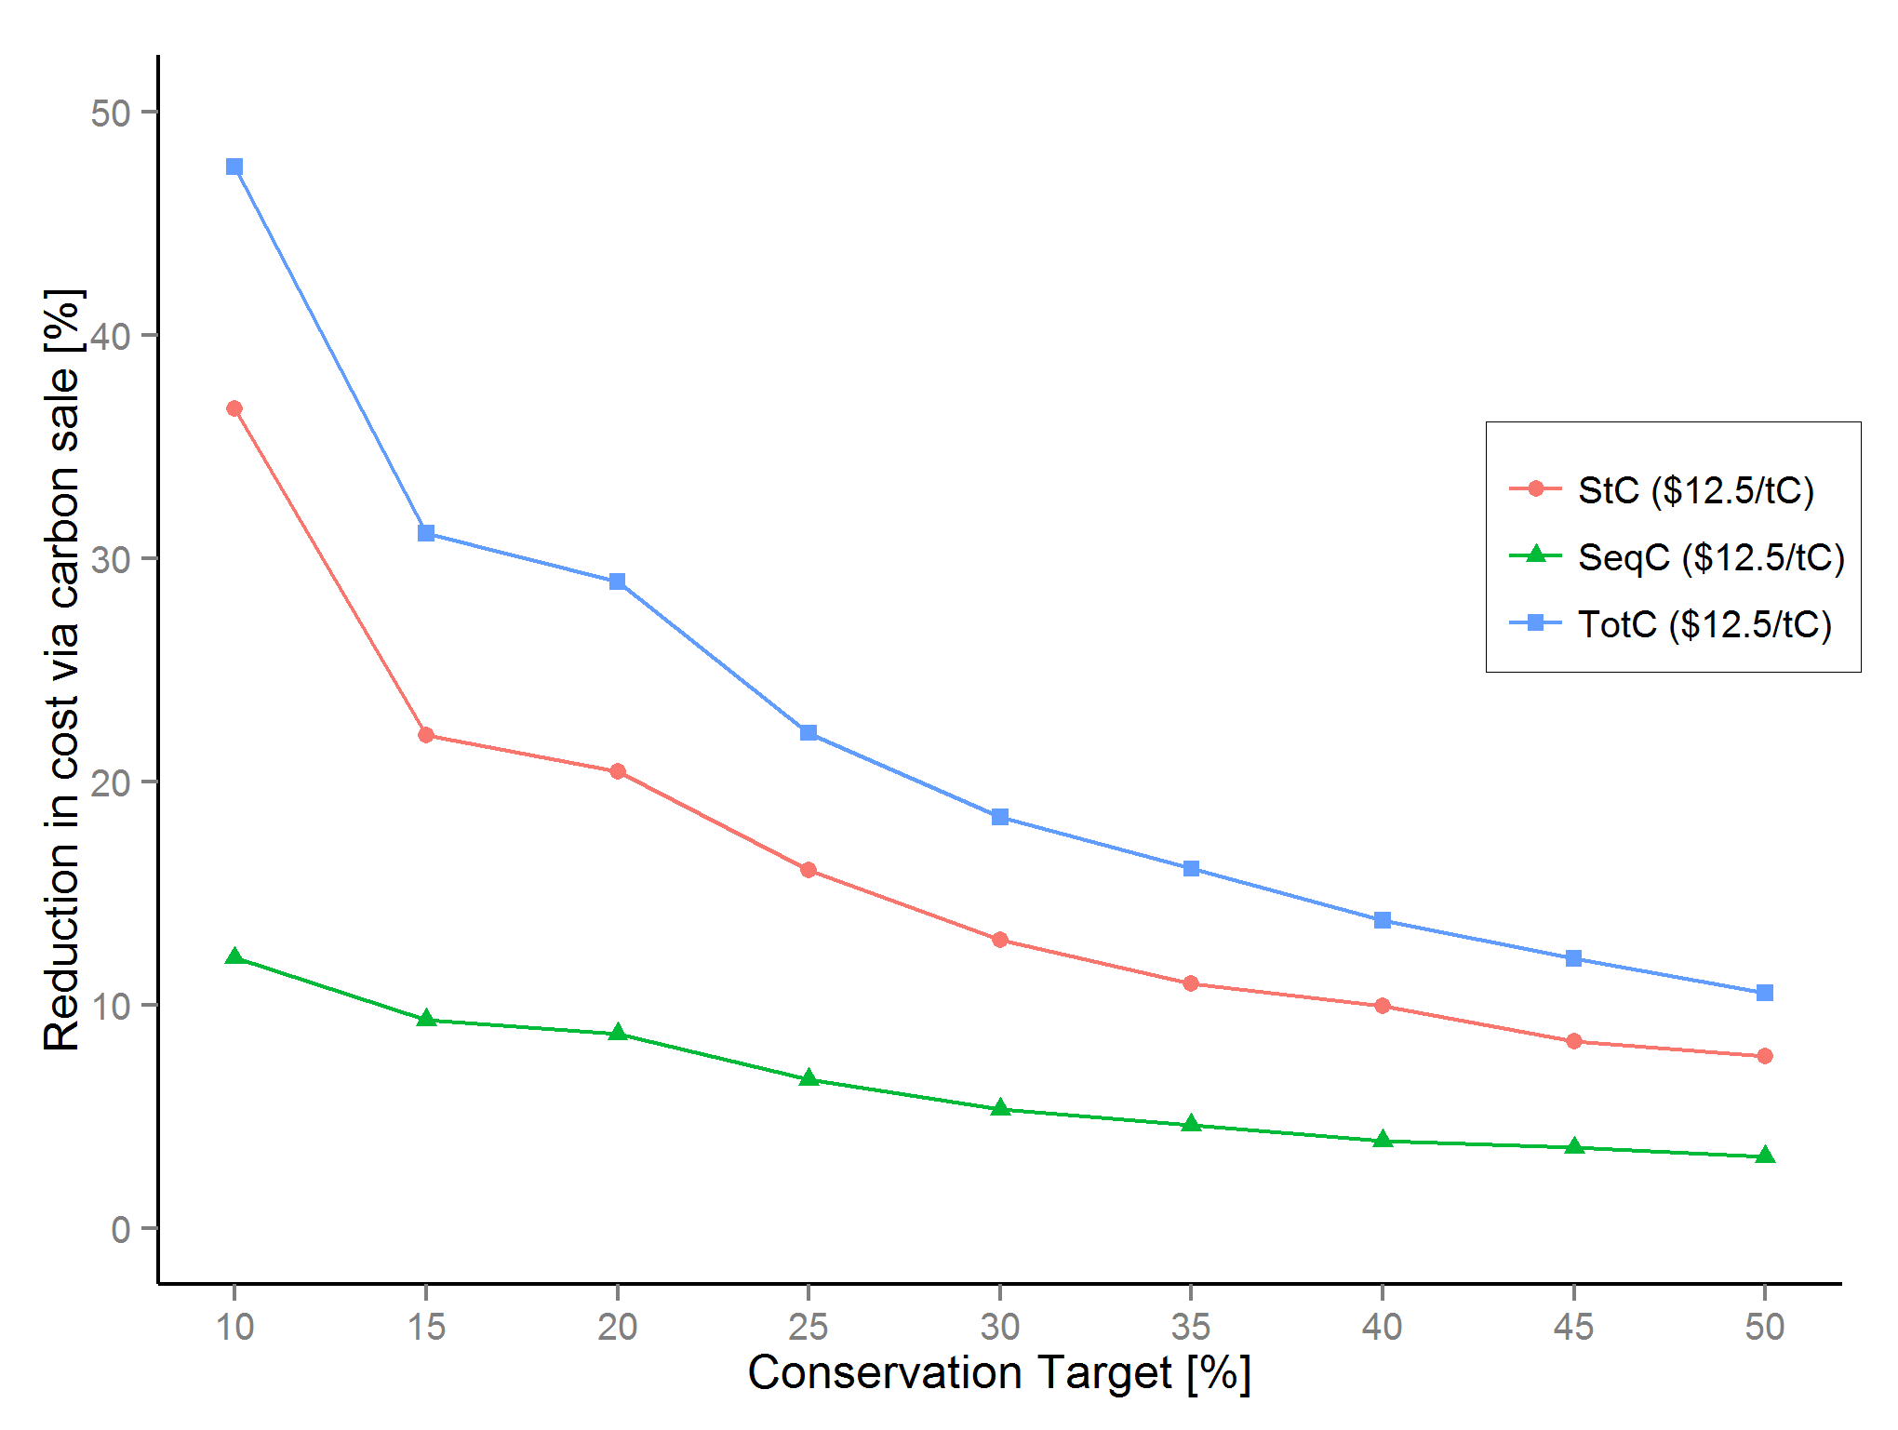
Biodiversity - Carbon
Huge Initial Reductions in Cost Possible
Schuster, Martin & Arcese 2014 PLoS One

Slide 13
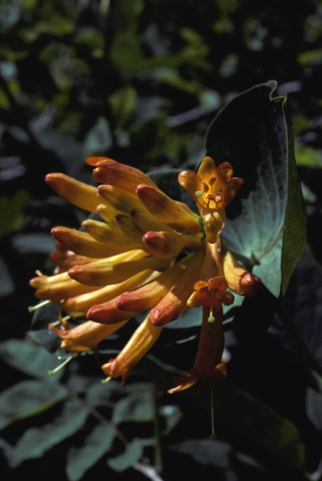
Minimizing Long-term Management Costs
Conservation requires more than land protection
Management costs may include:
Restoring invaded habitats
Restricting detrimental human activities (ATVs, Dogs, etc.)
Controlling over-abundant species
Maintaining historic disturbances (fire)
Can we prioritize activities or properties to minimize these costs?

Slide 14
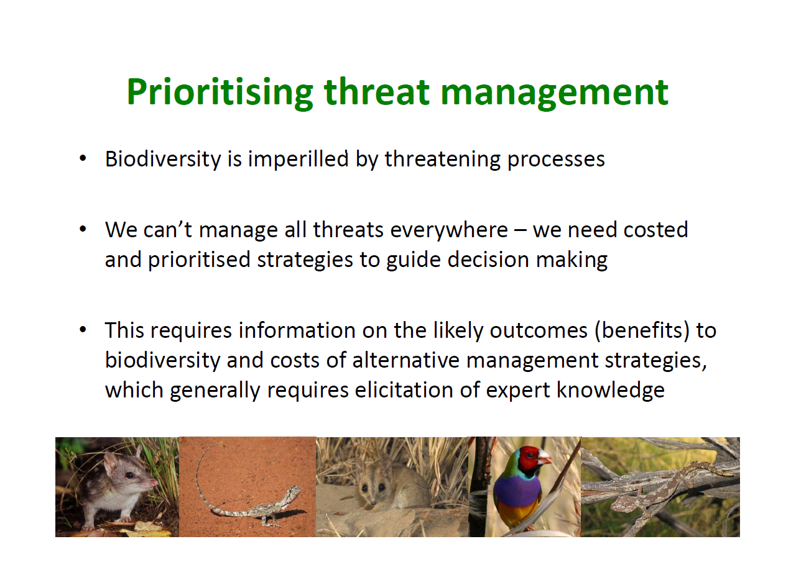
An Australian Example

Slide 15
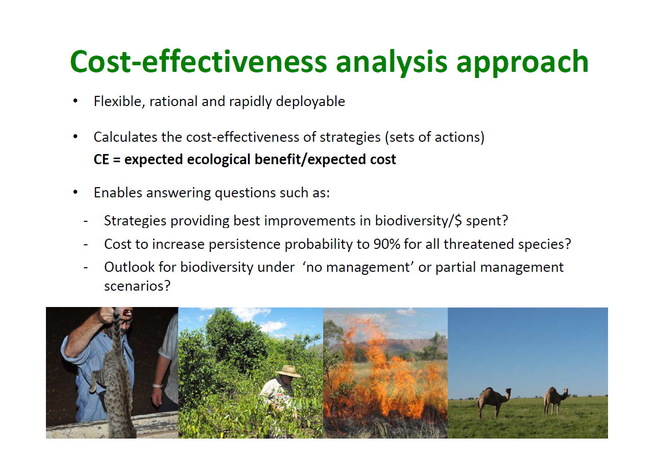

Slide 16
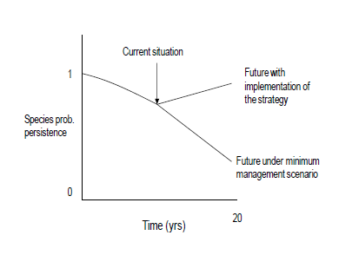
Estimating the Benefits of An Action
Estimate the cost of the action, given benefit and feasibility

Slide 17
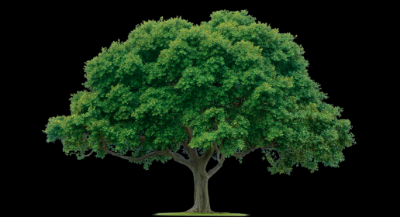
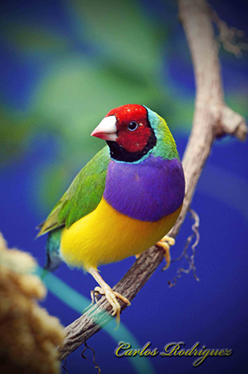

Estimating the Benefits of An Action
Action 1: Protect More Habitat
1) Socially Feasibility
2) Cost
3) Expected Benefit
Action 2: Kill a Cat
Gouldian Finches
Under Threat of Habitat Loss and Mortality due to Feral Cats

Slide 18
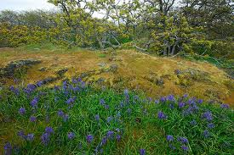
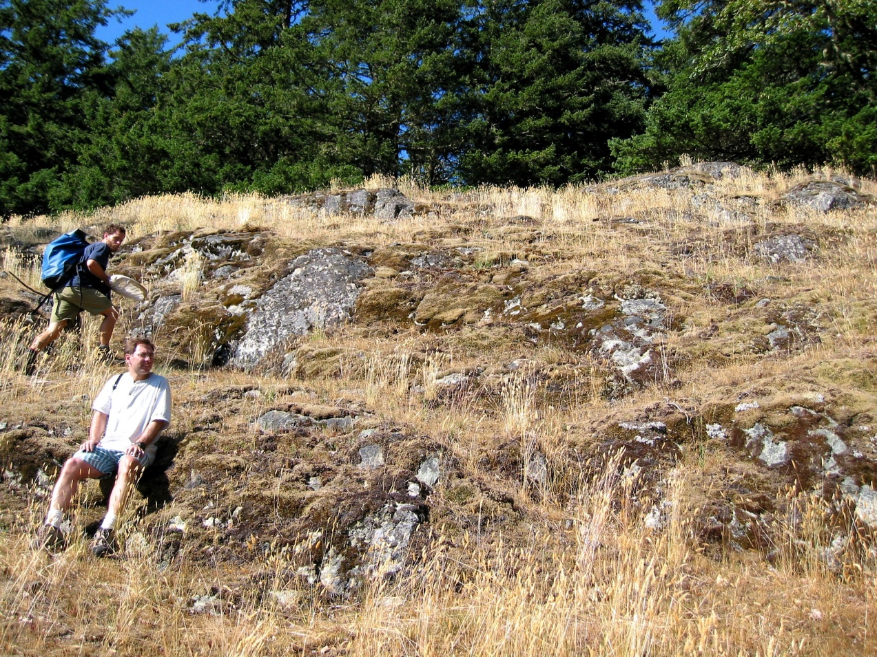
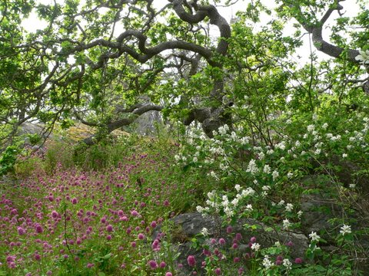
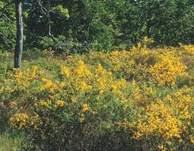
How Do Restoration Costs Vary with Degree of Invasion?
High Native Cover vs High Exotic Cover

Slide 19
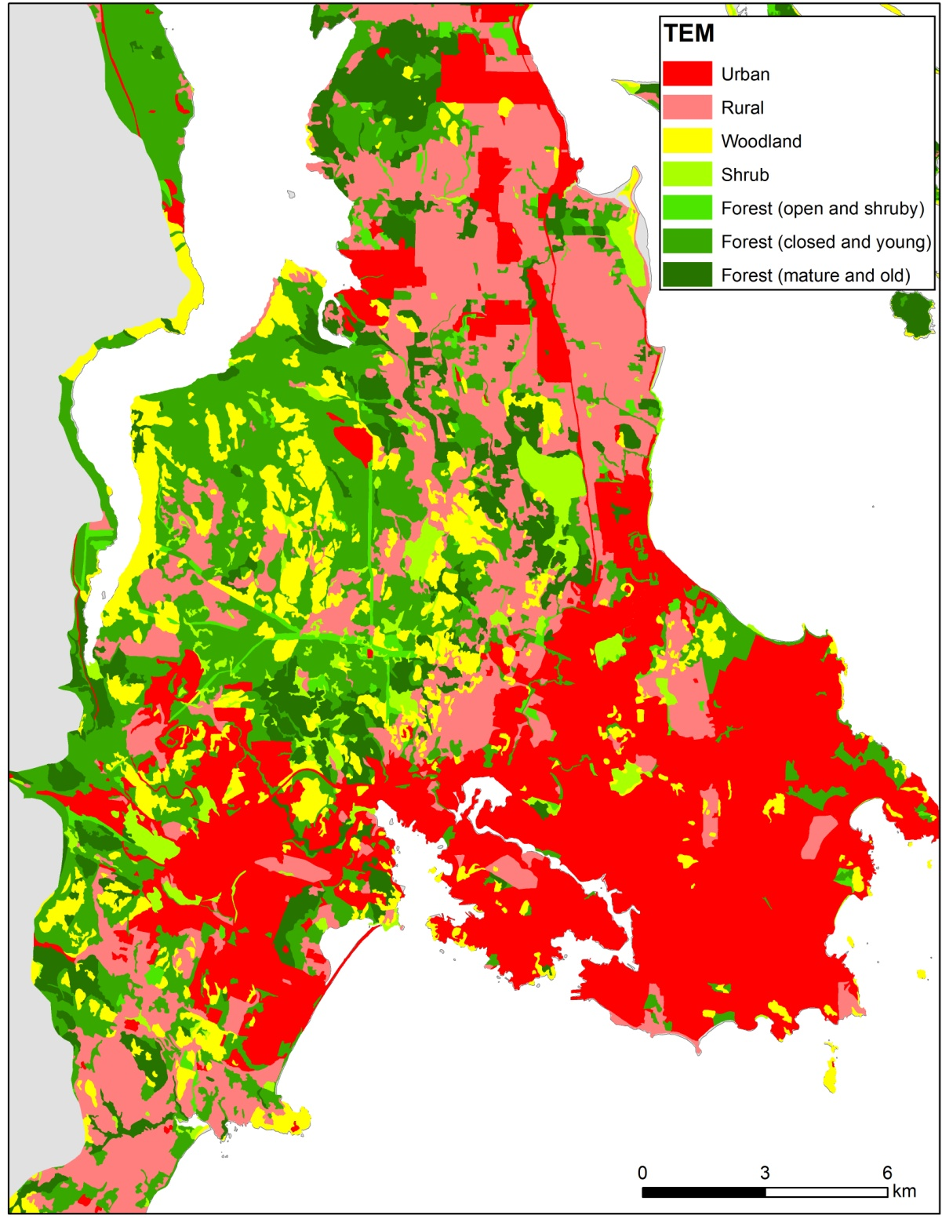
How Might Long-term Management Costs Influenced by Landscape Context?
Can We Use Expert Opinion to Prioritize Management Actions to Inform this Choice?

Slide 20
Highest Benefit in Sites with moderate invasion and little rural-urban habitat with 1 km buffer
Lowest in Sites with High Invasion and rural-urban with 1 km

Slide 23
How Might Landscape Context Influence the Cost of Alternative Acquisitions?
Example Criteria (benefits and costs of acquiring these sites)?
Area of Mature Forest
Viability (Size, Surrounding area)
Representation
Protected areas

Slide 24
Summary
In Human-Dominated Landscapes Incentives to Manage Private Land for Conservation Values are Likely to Play a Key Role in Conservation Area Design
Existing Land Use Regulations, Such as Agricultural Land Tax Credits, Can Act as Positively or Negatively on Conservation Outcomes
Prioritizing Land Acquisition to Minimize Long-term Costs will be Essential to Maximizing the Value of Conservation Investment

